Slide 1
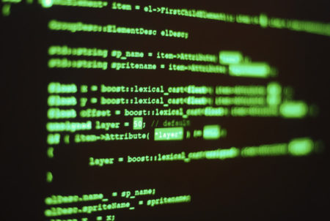
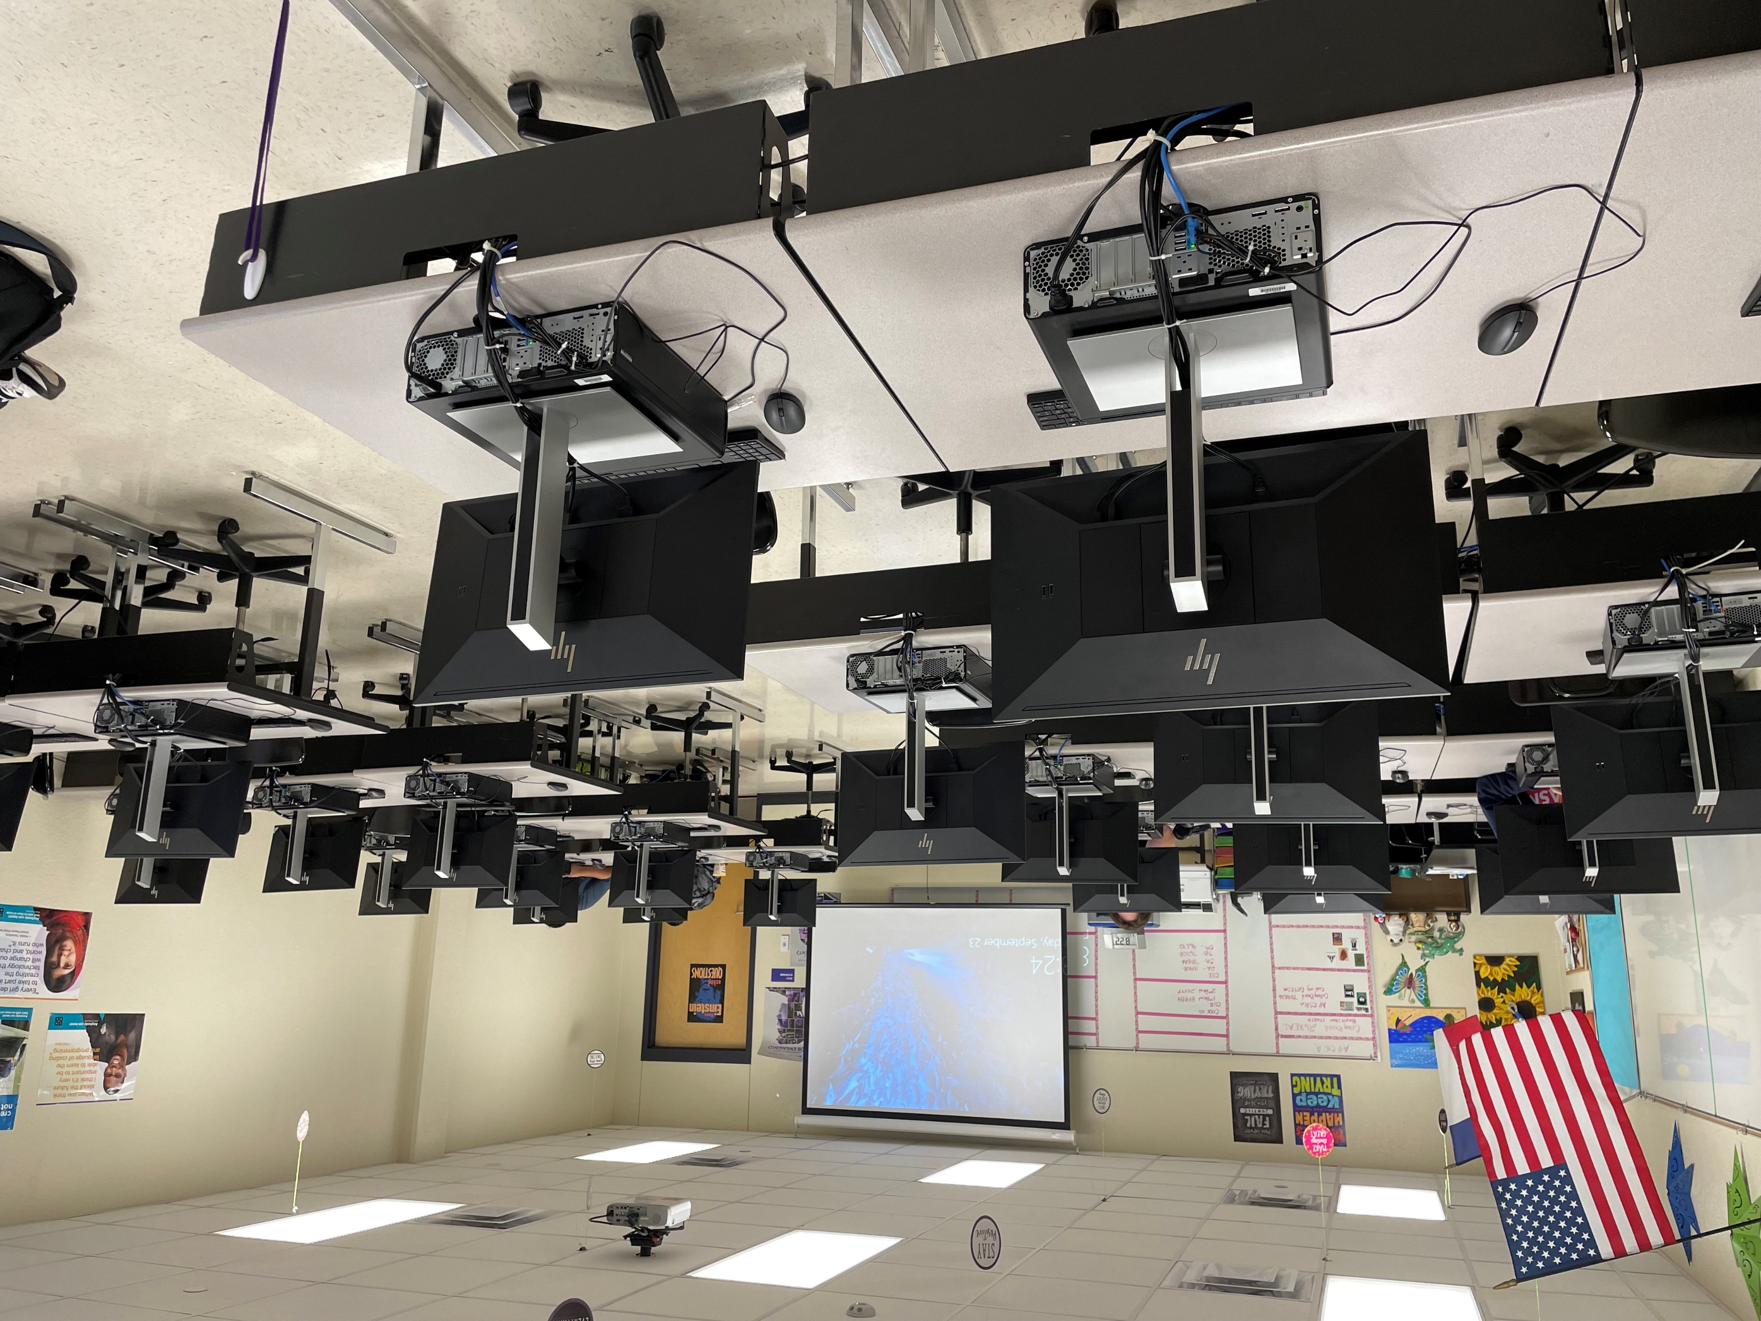
Programming and Software Development
Statewide Program of Study
Science, Technology, Engineering, and Mathematics Career Cluster
The Science, Technology, Engineering, and Mathematics (STEM) Career Cluster focuses on planning, managing, and providing, scientific research and professional and technical services, including laboratory and testing services, and research and development services.
The Programming and Software Development program of study explores the occupations and education opportunities associated with researching, designing, developing, and testing operating systems-level software, compilers, and network distribution software for medical, industrial, military, communications, aerospace, business, scientific, and general computer applications. This program of study may also include exploration into creating, modifying, and testing the codes, forms, and script that allow computer applications to run.
Work-Based Learning and
Expanded Learning Opportunities
Exploration Activities | Work-Based Learning Activities
Participate in a coding club at school | Obtain a programming IBC
Secondary Courses for High School Credit
1 Computer Science I
2 Computer Science II
3 AP Computer Science Principles
4 AP Computer Science A (MATH/LOTE)
Industry-Based Certifications
C++ Certified Associate Programmer
Certified Entry-Level Python Programmer (PCEP)
Postsecondary Opportunities
Associates Degrees
Computer Programming/Programmer General
Computer Software Engineer
Computer Science
Certified Software Analyst
Bachelor’s Degrees
Management Information Systems, General
Computer Software Engineer
Computer Science
Information Science/ Studies
Master’s, Doctoral, and Professional Degrees
Computer Software Engineer
Computer Science
Information Science/ Studies
SMHS Computer Science Lab
Aligned Occupations
Occupations | Median Wage | Annual Openings | % Growth
Software Developer, Systems Software | $103,334 | 2,985 | 25%
Software Developers, Application | $104,499 | 6,311 | 30%
Computer Programmers | $79,893 | 1,454 | 9%
Successful completion of the Programming and Software Development program of study will fulfill requirements of the Business and Industry endorsement and STEM endorsement if the math and science requirements are met. Revised – August 2022

Slide 2
Programming and Software Development Course Information
COURSE NAME | SERVICE ID | PREREQUISITES | COREQUISITES
Computer Science I | 03580200 (1 credit) 6376 | None | Algebra I
Computer Science II | 03580300 (1 credit) 6377 | Algebra I, Computer Science I | None
AP Computer Science Principles | A3580300 (1 credit) 6371 | Algebra I | None
AP Computer Science A, MATH, LOTE | A3580110 (1 credit) A3580120 (1 credit) 6367/6382 | AP Computer Science Principles | None
FOR ADDITIONAL INFORMATION ON THE SCIENCE, TECHNOLOGY, ENGINEERING, AND MATHEMATICS CAREER CLUSTER,
PLEASE CONTACT: CJ Odam, SMCISD CTE Coordinator cj.odam@smcisd.net
San Marcos CISD does not discriminate on the basis of race, color, national origin, sex, disability or age in its programs or activities and provides equal access to the Boy Scouts and other designated youth groups. The following person has been designated to handle inquiries regarding the nondiscrimination policies: Stephanie Munoz ; 631 Mill St, San Marcos, TX 78666 ; 512-393-6700 ; stephanie.munoz@smcisd.net
Further nondiscrimination information can be found at smcisd.net/cte

